Slide 1
[BigData] 07 Convolutional Neural Networks and Recurrent Neural Networks
Jen-Wei Huang 黃仁暐
Department of Electrical Engineering, NCKU

Slide 2
Convolutional Neural Networks

Slide 3
The Image Recognition Problem
Suppose that we have an image
200*200 pixels
Each pixel has 3 color value (RGB)
If we use NN to train an image recognition model
200*200*3 inputs for the image
Using just 1 neuron in the hidden layer
=> 12,0000 weights need to be trained
Too many parameters might lead to overfitting

Slide 4
In the Real World
The human eyes cannot see a pixel
Actually human can only see 300 pixels per inch
Each pixel is similar to the neighboring pixels
Can we consider a block of pixels as an input?
Consider a 10*10 filter to be applied on the image
The image becomes 20*20
# of parameter becomes 20*20*3=1200
Much fewer parameters

Slide 5

A Brief Example for Convolutional Neural Network
dog
Pooling
Layer
Convolution
Layer
Pooling
Layer
Fully
Connected
Layer
Input Layer
Convolution
Layer

Slide 6
The Image Input
3 | 1 | 2 | 5 | 8 | 4
4 | 5 | 2 | 6 | 1 | 3
-1 | 3 | 2 | 1 | 4 | 6
2 | -5 | 8 | -5 | -4 | 2
-2 | -4 | 2 | 1 | -3 | -5
4 | -5 | 1 | 1 | -3 | 2

Slide 7
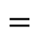

Convolution
The filters are called convolution kernels in CNN
The size of kernel is a hyper parameter
Larger kernel leads to lower resolutions
Larger kernel leads to fewer parameters
Larger kernel leads to lower accuracy
3 | 1 | 2 | 5 | 8 | 4
4 | 5 | 2 | 6 | 1 | 3
-1 | 3 | 2 | 1 | 4 | 6
2 | -5 | 8 | -5 | -4 | 2
-2 | -4 | 2 | 1 | -3 | -5
4 | -5 | 1 | 1 | -3 | 2
-6 | 3 | 2
8 | -10 | -6
-1 | -3 | -2
-2 | 3 | 1
2 | -2 | -3
1 | -1 | -1
$$×$$
$$=$$

Slide 8
Pooling Layer
Choose the most important feature in the block
Average number (average pooling)
Maximum in the block (max-pooling)
Reduce the dimensions
-6 | 3 | 2
8 | -10 | -6
-1 | -3 | -2
-1.67
Average pooling
-6 | 3 | 2
8 | -10 | -6
-1 | -3 | -2
8
Max-pooling

Slide 9
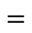

Convolution and Pooling Step by Step
3 | 1 | 2 | 5 | 8 | 4
4 | 5 | 2 | 6 | 1 | 3
-1 | 3 | 2 | 1 | 4 | 6
2 | -5 | 8 | -5 | -4 | 2
-2 | -4 | 2 | 1 | -3 | -5
4 | -5 | 1 | 1 | -3 | 2
8 | 10 | 15 | 24
-2 | 3 | 1
2 | -2 | -3
1 | -1 | -1
$$×$$
$$=$$
-6 | 3 | 2
8 | -10 | -6
-1 | -3 | -2
-2 | 6 | 5
10 | -4 | -18
3 | -2 | -1
-4 | 15 | 8
4 | -12 | -3
2 | -1 | -4
-10 | 24 | 4
12 | -2 | -12
1 | -4 | -6

Slide 10
Convolution and Pooling Step by Step
3 | 1 | 2 | 5 | 8 | 4
4 | 5 | 2 | 6 | 1 | 3
-1 | 3 | 2 | 1 | 4 | 6
2 | -5 | 8 | -5 | -4 | 2
-2 | -4 | 2 | 1 | -3 | -5
4 | -5 | 1 | 1 | -3 | 2
8 | 10 | 15 | 24
8 | 10 | 15 | 24
15 | 6 | 18 | 4
-2 | 3 | 1
2 | -2 | -3
1 | -1 | -1
$$×$$
$$=$$
-8 | 15 | 2
-2 | -6 | -6
2 | -3 | -2
-10 | 6 | 6
6 | -4 | -3
-5 | -8 | 5
-4 | 18 | 1
4 | -2 | -12
8 | 5 | -4
-12 | 3 | 3
2 | -8 | -18
-5 | 4 | -2

Slide 11
Convolution and Pooling Step by Step
3 | 1 | 2 | 5 | 8 | 4
4 | 5 | 2 | 6 | 1 | 3
-1 | 3 | 2 | 1 | 4 | 6
2 | -5 | 8 | -5 | -4 | 2
-2 | -4 | 2 | 1 | -3 | -5
4 | -5 | 1 | 1 | -3 | 2
8 | 10 | 15 | 24
15 | 6 | 18 | 4
8 | 10 | 15 | 24
15 | 6 | 18 | 4
10 | 15 | 16 | 12
-2 | 3 | 1
2 | -2 | -3
1 | -1 | -1
$$×$$
$$=$$
2 | 9 | 2
4 | 10 | -24
-2 | 4 | -2
-6 | 6 | 1
-10 | -16 | 15
-4 | -2 | -1
-4 | 3 | 4
16 | 10 | 12
2 | -1 | 3
-2 | 12 | 6
-10 | 8 | -6
1 | 3 | 5

Slide 12
Convolution and Pooling Step by Step
3 | 1 | 2 | 5 | 8 | 4
4 | 5 | 2 | 6 | 1 | 3
-1 | 3 | 2 | 1 | 4 | 6
2 | -5 | 8 | -5 | -4 | 2
-2 | -4 | 2 | 1 | -3 | -5
4 | -5 | 1 | 1 | -3 | 2
8 | 10 | 15 | 24
15 | 6 | 18 | 4
10 | 15 | 16 | 12
8 | 10 | 15 | 24
15 | 6 | 18 | 4
10 | 15 | 16 | 12
8 | 24 | 9 | 15
-2 | 3 | 1
2 | -2 | -3
1 | -1 | -1
$$×$$
$$=$$
-4 | -15 | 8
-4 | 8 | 6
4 | 5 | -1
10 | 24 | -5
-8 | -4 | -3
-5 | -1 | 1
-16 | -15 | -4
4 | -2 | 9
1 | -1 | 3
10 | -12 | 2
2 | 6 | 15
1 | 3 | -2

Slide 13
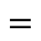

After Convolution and Pooling
A figure becomes a feature map by a filter
3 | 1 | 2 | 5 | 8 | 4
4 | 5 | 2 | 6 | 1 | 3
-1 | 3 | 2 | 1 | 4 | 6
2 | -5 | 8 | -5 | -4 | 2
-2 | -4 | 2 | 1 | -3 | -5
4 | -5 | 1 | 1 | -3 | 2
8 | 10 | 15 | 24
15 | 6 | 18 | 4
10 | 15 | 16 | 12
8 | 24 | 9 | 15
-2 | 3 | 1
2 | -2 | -3
1 | -1 | -1
$$×$$
$$=$$

Slide 14
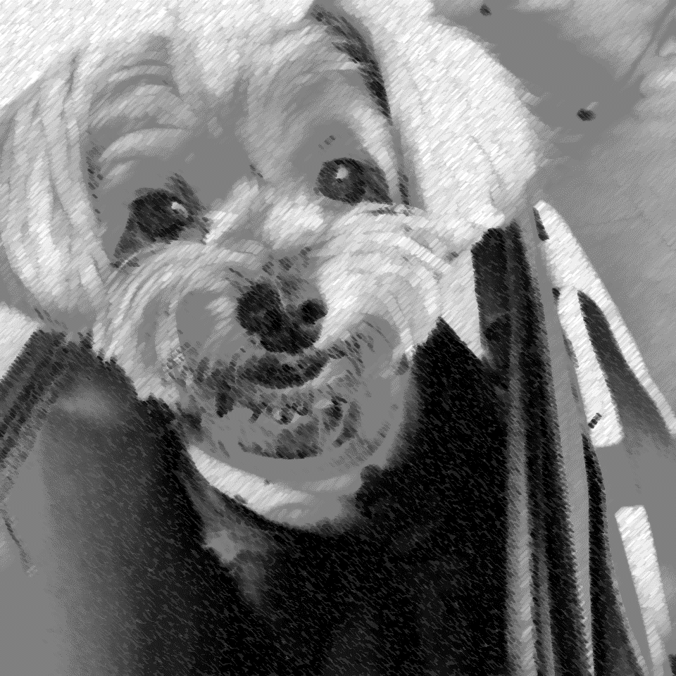
After Convolution and Pooling
Many filters →Many feature maps
Different filters
-2 | 3 | 1
2 | -2 | -3
1 | -1 | -1
5 | -1 | 4
4 | 1 | 2
-2 | 3 | 2
2 | -3 | -1
-2 | 2 | 3
-1 | 1 | 1
……

Slide 15
A Brief Example for Convolutional Neural Network
dog
Pooling
Layer
Convolution
Layer
Pooling
Layer
Fully
Connected
Layer
Input Layer
Convolution
Layer

Slide 16
How to Design a Good CNN

Slide 17
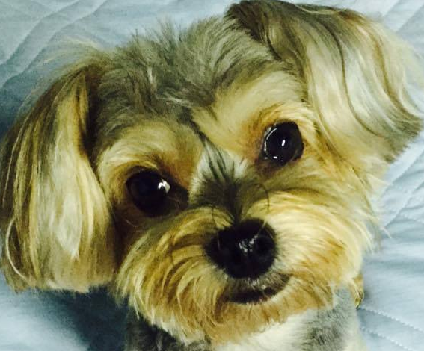
1st problem: Different Sizes of Images
3 | 1 | 2 | 5 | 8 | 4
4 | 5 | 2 | 6 | 1 | 3
-1 | 3 | 2 | 1 | 4 | 6
2 | -5 | 8 | -5 | -4 | 2
-2 | -4 | 2 | 1 | -3 | -5
4 | -5 | 1 | 1 | -3 | 2
2 | 4 | -3 | 1 | -3
5 | -3 | 4 | 2 | -3
1 | 2 | 1 | 1 | -2
4 | -1 | 2 | -3 | 1
3 | -1 | 1 | 5 | 1

Slide 18
2nd problem: The Boundaries of Images
3 | 1 | 2 | 5 | 8 | 4
4 | 5 | 2 | 6 | 1 | 3
-1 | 3 | 2 | 1 | 4 | 6
2 | -5 | 8 | -5 | -4 | 2
-2 | -4 | 2 | 1 | -3 | -5
4 | -5 | 1 | 1 | -3 | 2

Slide 19
The Solution: Zero Padding
0 | 0 | 0 | 0 | 0 | 0 | 0 | 0
0 | 3 | 1 | 2 | 5 | 8 | 4 | 0
0 | 4 | 5 | 2 | 6 | 1 | 3 | 0
0 | -1 | 3 | 2 | 1 | 4 | 6 | 0
0 | 2 | -5 | 8 | -5 | -4 | 2 | 0
0 | -2 | -4 | 2 | 1 | -3 | -5 | 0
0 | 4 | -5 | 1 | 1 | -3 | 2 | 0
0 | 0 | 0 | 0 | 0 | 0 | 0 | 0
0 | 0 | 0 | 0 | 0 | 0 | 0 | 0
0 | 0 | 0 | 0 | 0 | 0 | 0 | 0
0 | 0 | 2 | 4 | -3 | 1 | -3 | 0
0 | 0 | 5 | -3 | 4 | 2 | -3 | 0
0 | 0 | 1 | 2 | 1 | 1 | -2 | 0
0 | 0 | 4 | -1 | 2 | -3 | 1 | 0
0 | 0 | 3 | -1 | 1 | 5 | 1 | 0
0 | 0 | 0 | 0 | 0 | 0 | 0 | 0

Slide 20
The Hyper Parameters for CNN
Kernel sizes
The size of your filter
Larger: fewer parameters but lower resolutions
Smaller: higher resolutions but more parameters
Stride
The shifts of the filter for each convolution action

Slide 21
Kernel Sizes
K=2
0 | 0 | 0 | 0 | 0 | 0 | 0 | 0
0 | 3 | 1 | 2 | 5 | 8 | 4 | 0
0 | 4 | 5 | 2 | 6 | 1 | 3 | 0
0 | -1 | 3 | 2 | 1 | 4 | 6 | 0
0 | 2 | -5 | 8 | -5 | -4 | 2 | 0
0 | -2 | -4 | 2 | 1 | -3 | -5 | 0
0 | 4 | -5 | 1 | 1 | -3 | 2 | 0
0 | 0 | 0 | 0 | 0 | 0 | 0 | 0
K=3

Slide 22
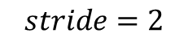
Stride
$$stride=2$$
0 | 0 | 0 | 0 | 0 | 0 | 0 | 0
0 | 3 | 1 | 2 | 5 | 8 | 4 | 0
0 | 4 | 5 | 2 | 6 | 1 | 3 | 0
0 | -1 | 3 | 2 | 1 | 4 | 6 | 0
0 | 2 | -5 | 8 | -5 | -4 | 2 | 0
0 | -2 | -4 | 2 | 1 | -3 | -5 | 0
0 | 4 | -5 | 1 | 1 | -3 | 2 | 0
0 | 0 | 0 | 0 | 0 | 0 | 0 | 0
0 | 0 | 0 | 0 | 0 | 0 | 0 | 0
0 | 3 | 1 | 2 | 5 | 8 | 4 | 0
0 | 4 | 5 | 2 | 6 | 1 | 3 | 0
0 | -1 | 3 | 2 | 1 | 4 | 6 | 0
0 | 2 | -5 | 8 | -5 | -4 | 2 | 0
0 | -2 | -4 | 2 | 1 | -3 | -5 | 0
0 | 4 | -5 | 1 | 1 | -3 | 2 | 0
0 | 0 | 0 | 0 | 0 | 0 | 0 | 0

Slide 23
The Hyper Parameters for CNN
Depth
How many feature maps in each convolution layer
Parameter sharing
If a feature map shares the same weight
Number of convolution and pooling layers
Pooling functions (max/average/…?)
The dimensions of fully connected layers
Activation functions
Dropouts

Slide 24
The Number of Parameters
For an input image with L*L=300*300 pixels
Kernel size K=4
Stride S=2
Zero-padding P= 1
Depth D=96
The width of feature maps = (300-4+2*1)/2+1=150
width=(L-K+2P)/S+1
The size of each feature map = 150*150
You can use feature maps with different sizes

Slide 25
The Number of Parameters
The size of feature maps = 150*150
The volume of 1st convolution layer
=150*150*96 = 2160000
The parameters in a filter = 4*4*3+1 = 49
Without parameter sharing
2160000*49=105840000
With parameter sharing
96*49=4704

Slide 26
Which Data is Good for CNN
The neighboring data have some relations
The neighboring data are similar to one another
Locality!

Slide 27
Recurrent Neural Networks

Slide 28
Consider a Problem
The relation between input？
…
DNN

Slide 29








Recurrent Neural Networks
$$h_{0}$$
$$h_{1}$$
$$h_{2}$$
$$h_{n}$$
NN
NN
NN
NN
……
$$i_{0}$$
$$i_{1}$$
$$i_{2}$$
$$i_{n}$$

Slide 30






Inside a Standard RNN
$$h_{t−1}$$
$$h_{t}$$
$$h_{t+1}$$
NN
tanh
NN
tanh
tanh
$$i_{t−1}$$
$$i_{t}$$
$$i_{t+1}$$

Slide 31
The Types of RNN
One to many
Many to one
Many to many
Synced
Unsynced

Slide 32
One to Many
One input
Many outputs
The output have time dependency
E.g.) Image captioning

Slide 33
Many to One
Many inputs
The inputs have time dependency
One output
E.g.) Sentiment analysis

Slide 34
Many to Many (synced)
Many inputs
Many outputs
All of them have time dependency
Input size is the same as output size
E.g.) Predicting the next word

Slide 35
Many to Many (unsynced)
Many inputs
Many outputs
All of them have time dependency
The lengths could be different
E.g.) Translation

Slide 36






Training on RNN
Back propagation through time
The error should propagate to previous nodes
$$h_{0}$$
$$h_{1}$$
$$h_{2}$$
NN
NN
NN
$$i_{0}$$
$$i_{1}$$
$$i_{2}$$

Slide 37
Long Short Term Memory

Slide 38




Another Problem of RNN
The relation between them？
$$h_{0}$$
$$h_{n}$$
NN
NN
……
$$i_{0}$$
$$i_{n}$$

Slide 39
The Memories in LSTM
Short term
Record the neighboring input
Traditional RNN
Long term
Record the far away input

Slide 40


The Structure of LSTM
$$h_{t−1}$$
$$h_{t}$$
$$h_{t+1}$$
X
+
X
+
X
+
$$tanh$$
$$tanh$$
$$tanh$$
X
X
X
X
X
X
$$σ$$
$$σ$$
$$tanh$$
$$σ$$
$$σ$$
$$σ$$
$$tanh$$
$$σ$$
$$σ$$
$$σ$$
$$tanh$$
$$σ$$
$$i_{t−1}$$
$$i_{t}$$
$$i_{t+1}$$

Slide 41
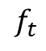

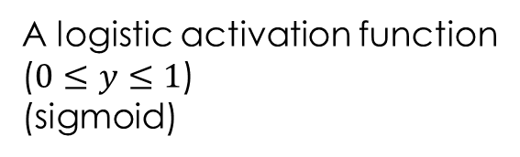

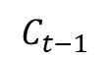

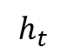


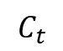
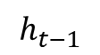


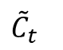

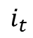

The meaning in each block
Multiply the vector
element by element
$$h_{t}$$
Sum the vector
Element by element
$$C_{t−1}$$
$$C_{t}$$
X
+
$$tanh$$
$$f_{t}$$
$$i_{t}$$
X
X
$${\tilde{C}}_{t}$$
$$h_{t−1}$$
$$σ$$
$$σ$$
$$tanh$$
$$σ$$
$$h_{t}$$
Connect 2 vector
x, y as 1 vector
[ x, y ]
$$i_{t}$$
A logistic activation function
($0≤y≤1$)
(sigmoid)

Slide 42


The Memory in LSTM
Record the previous outputs
Long term memory
$$h_{t}$$
$$C_{t−1}$$
$$C_{t}$$
X
+
$$tanh$$
X
X
$$h_{t−1}$$
$$σ$$
$$σ$$
$$tanh$$
$$σ$$
$$h_{t}$$
$$i_{t}$$

Slide 43

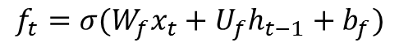
Forget Gate
Determine if we need to use the data from long term memory
$$h_{t}$$
$$C_{t−1}$$
$$C_{t}$$
X
+
$$tanh$$
$$f_{t}$$
X
X
$$h_{t−1}$$
$$σ$$
$$σ$$
$$tanh$$
$$σ$$
$$h_{t}$$
$$i_{t}$$
$$f_{t}=σ(W_{f}x_{t}+U_{f}h_{t−1}+b_{f})$$

Slide 44
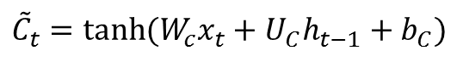
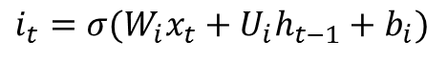
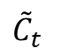
Input Gate
Determine if we need to consider data from short term memory
$$h_{t}$$
$${\tilde{C}}_{t}=tanh⁡(W_{c}x_{t}+U_{C}h_{t−1}+b_{C})$$
$$C_{t−1}$$
$$C_{t}$$
X
+
$$tanh$$
$$i_{t}$$
X
X
$${\tilde{C}}_{t}$$
$$h_{t−1}$$
$$σ$$
$$σ$$
$$tanh$$
$$σ$$
$$h_{t}$$
$$i_{t}$$
$$i_{t}=σ(W_{i}x_{t}+U_{i}h_{t−1}+b_{i})$$

Slide 45
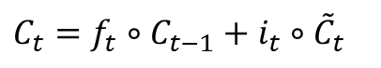
Update Cell State
Update the data on long term memory
$$h_{t}$$
$$C_{t}=f_{t}∘C_{t−1}+i_{t}∘{\tilde{C}}_{t}$$
$$C_{t−1}$$
$$C_{t}$$
X
+
$$tanh$$
$$f_{t}$$
$$i_{t}$$
X
X
$${\tilde{C}}_{t}$$
$$h_{t−1}$$
$$σ$$
$$σ$$
$$tanh$$
$$σ$$
$$h_{t}$$
$$i_{t}$$

Slide 46
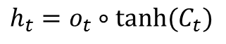
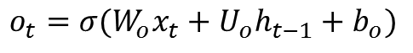
Output Gate
Determine if we need previous data in next time
$$h_{t}$$
$$h_{t}=o_{t}∘tanh⁡(C_{t})$$
$$C_{t−1}$$
$$C_{t}$$
X
+
$$tanh$$
$$f_{t}$$
$$i_{t}$$
X
X
$${\tilde{C}}_{t}$$
$$h_{t−1}$$
$$σ$$
$$σ$$
$$tanh$$
$$σ$$
$$h_{t}$$
$$i_{t}$$
$$o_{t}=σ(W_{o}x_{t}+U_{o}h_{t−1}+b_{o})$$

Slide 47
Training LSTM
$$h_{t}$$
$$C_{t−1}$$
$$C_{t}$$
X
+
$$tanh$$
$$f_{t}$$
$$i_{t}$$
X
X
$${\tilde{C}}_{t}$$
$$h_{t−1}$$
$$σ$$
$$σ$$
$$tanh$$
$$σ$$
$$h_{t}$$
$$i_{t}$$

Slide 48
How to design a good LSTM

Slide 49
The Hyper Parameters
Input dimensions
Output dimensions
Activation functions

Slide 50
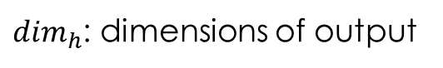
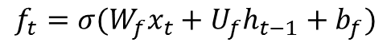
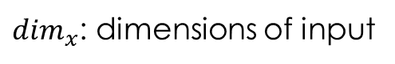
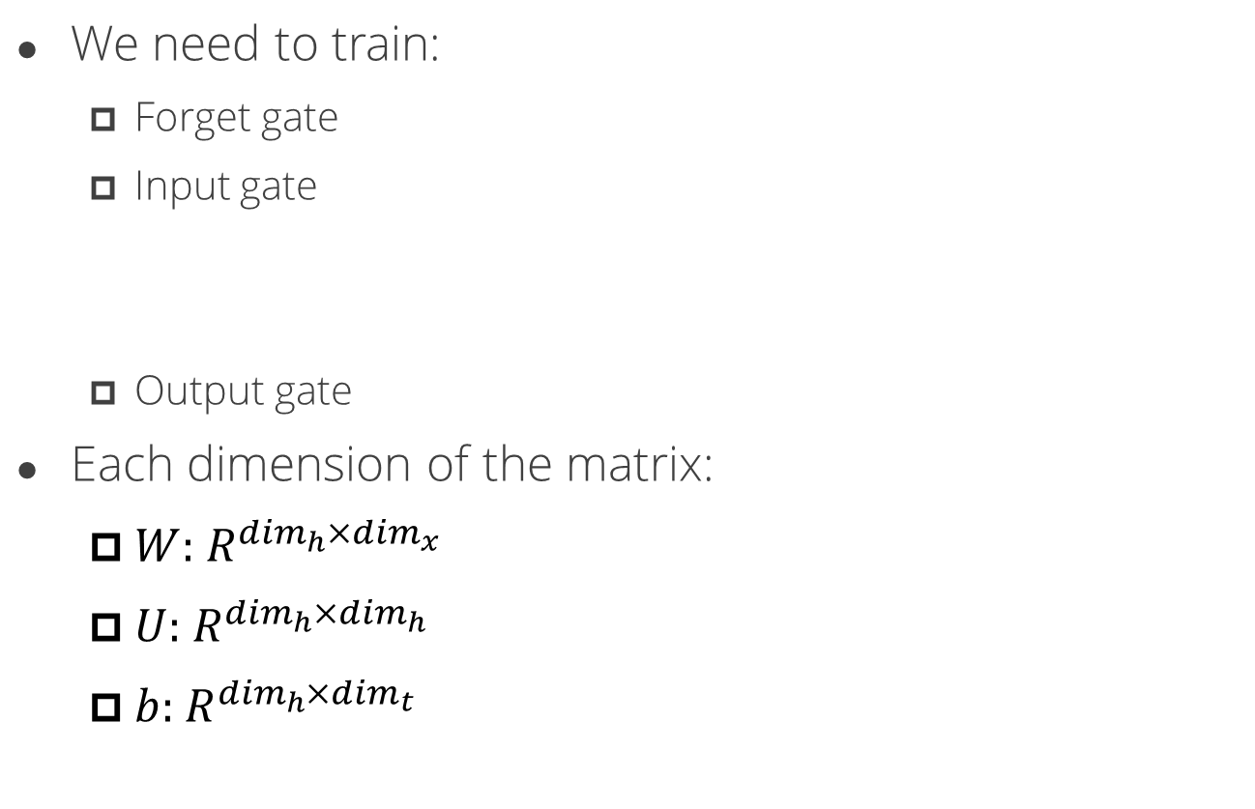
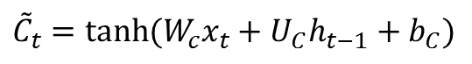
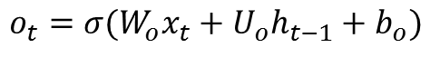
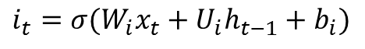
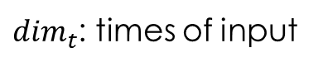
The Random Variables
We need to train:
Forget gate
Input gate
Output gate
Each dimension of the matrix:
$W:{ R}^{\dim_{h}{×\dim_{x}{ }}}$
$U:{ R}^{\dim_{h}{×\dim_{h}{ }}}$
$b:{ R}^{\dim_{h}{×\dim_{t}{ }}}$
$$f_{t}=σ(W_{f}x_{t}+U_{f}h_{t−1}+b_{f})$$
$$i_{t}=σ(W_{i}x_{t}+U_{i}h_{t−1}+b_{i})$$
$${\tilde{C}}_{t}=tanh⁡(W_{c}x_{t}+U_{C}h_{t−1}+b_{C})$$
$$o_{t}=σ(W_{o}x_{t}+U_{o}h_{t−1}+b_{o})$$
$\dim_{x}$: dimensions of input
$\dim_{h}$: dimensions of output
$\dim_{t}$: times of input

Slide 51
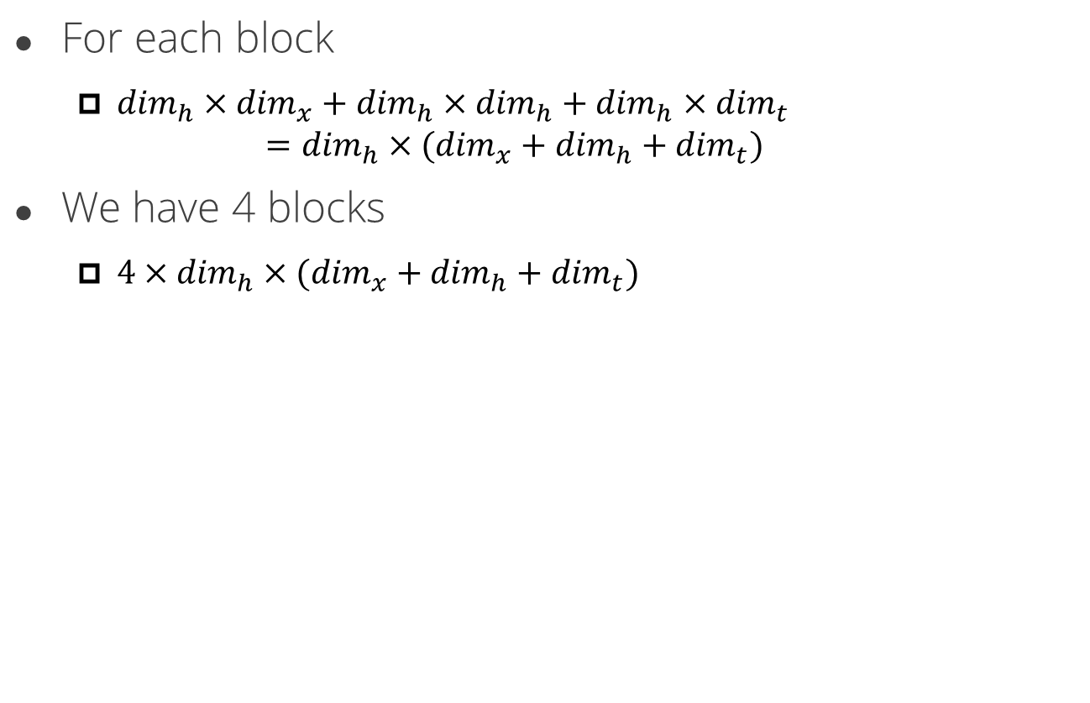
The Number of variables
For each block
$\dim_{h}×{\dim_{x}+dim}_{h}×\dim_{h}+\dim_{h}×\dim_{t}$ $=\dim_{h}×(\dim_{x}+\dim_{h}+\dim_{t})$
We have 4 blocks
$4×\dim_{h}×(\dim_{x}+\dim_{h}+\dim_{t})$

Slide 52
The Number of Variables
The input dimension is 30*10
Each input has 30 dimensions and data length is 10
The output dimension is 20
The total number of variable is
4*20*(30+20+10)=4800

Slide 53
Which Data is Good for LSTM
The data have long-term time dependency
Weather prediction
Time series prediction
Sentence analysis
Text

Slide 54

Thank you for your listening
Knowledge and Information Discovery Lab
http://kid.ee.ncku.edu.tw

Slide 55
backup

Slide 56
After Convolution and Pooling
3 | 1 | 2 | 5 | 8 | 4
4 | 5 | 2 | 6 | 1 | 3
-1 | 3 | 2 | 1 | 4 | 6
2 | -5 | 8 | -5 | -4 | 2
-2 | -4 | 2 | 1 | -3 | -5
4 | -5 | 1 | 1 | -3 | 2
8 | 10 | 15 | 24
-2 | 3 | 1
2 | -2 | -3
1 | -1 | -1
$$×$$
$$=$$
-6 | 3 | 2
8 | -10 | -6
-1 | -3 | -2
-2 | 6 | 5
10 | -4 | -18
3 | -2 | -1
-4 | 15 | 8
4 | -12 | -3
2 | -1 | -4
-10 | 24 | 4
12 | -2 | -12
1 | -4 | -6

Slide 57
After Convolution and Pooling
3 | 1 | 2 | 5 | 8 | 4
4 | 5 | 2 | 6 | 1 | 3
-1 | 3 | 2 | 1 | 4 | 6
2 | -5 | 8 | -5 | -4 | 2
-2 | -4 | 2 | 1 | -3 | -5
4 | -5 | 1 | 1 | -3 | 2
8 | 10 | 15 | 24
15 | 6 | 18 | 4
-2 | 3 | 1
2 | -2 | -3
1 | -1 | -1
$$×$$
$$=$$
-8 | 15 | 2
-2 | -6 | -6
2 | -3 | -2
-10 | 6 | 6
6 | -4 | -3
-5 | -8 | 5
-4 | 18 | 1
4 | -2 | -12
8 | 5 | -4
-12 | 3 | 3
2 | -8 | -18
-5 | 4 | -2

Slide 58
After Convolution and Pooling
3 | 1 | 2 | 5 | 8 | 4
4 | 5 | 2 | 6 | 1 | 3
-1 | 3 | 2 | 1 | 4 | 6
2 | -5 | 8 | -5 | -4 | 2
-2 | -4 | 2 | 1 | -3 | -5
4 | -5 | 1 | 1 | -3 | 2
8 | 10 | 15 | 24
15 | 6 | 18 | 4
10 | 15 | 16 | 12
-2 | 3 | 1
2 | -2 | -3
1 | -1 | -1
$$×$$
$$=$$
2 | 9 | 2
4 | 10 | -24
-2 | 4 | -2
-6 | 6 | 1
-10 | -16 | 15
-4 | -2 | -1
-4 | 3 | 4
16 | 10 | 12
2 | -1 | 3
-2 | 12 | 6
-10 | 8 | -6
1 | 3 | 5

Slide 59
After Convolution and Pooling
3 | 1 | 2 | 5 | 8 | 4
4 | 5 | 2 | 6 | 1 | 3
-1 | 3 | 2 | 1 | 4 | 6
2 | -5 | 8 | -5 | -4 | 2
-2 | -4 | 2 | 1 | -3 | -5
4 | -5 | 1 | 1 | -3 | 2
8 | 10 | 15 | 24
15 | 6 | 18 | 4
10 | 15 | 16 | 12
8 | 24 | 9 | 15
-2 | 3 | 1
2 | -2 | -3
1 | -1 | -1
$$×$$
$$=$$
-4 | -15 | 8
-4 | 8 | 6
4 | 5 | -1
10 | 24 | -5
-8 | -4 | -3
-5 | -1 | 1
-16 | -15 | -4
4 | -2 | 9
1 | -1 | 3
10 | -12 | 2
2 | 6 | 15
1 | 3 | -2

